Slide 1
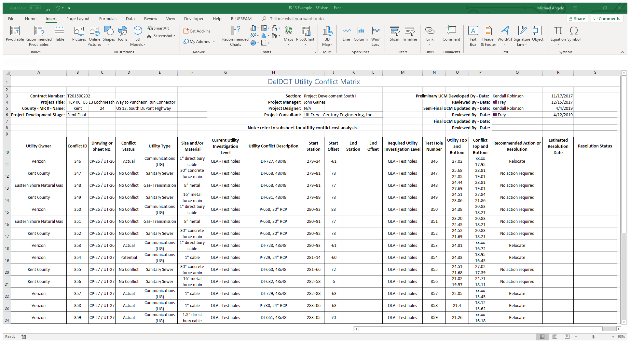
Utility Conflict MATRIX (UCM) TRAINING GUIDE JUNE 2020

Slide 2

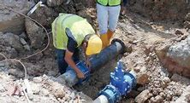
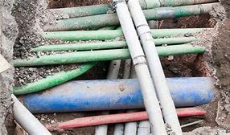
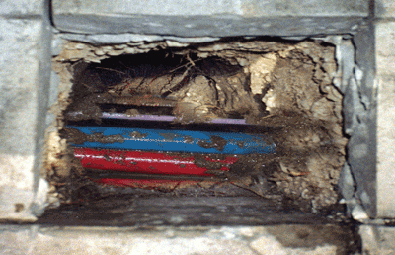
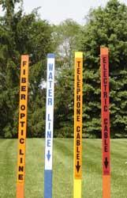
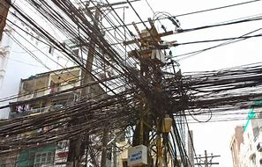
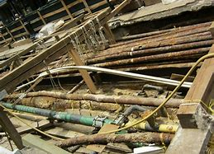
MANAGING Utility conflicts
Notes:
The importance of avoiding utility conflicts during the design and construction of highway and bridge projects cannot be overstated.
Unexpected utility conflicts can lead to costly redesign work, delays in project bidding, or costly and time-consuming construction delays for both the DOT and the utility company.
Utility Conflict Management tools have been developed to assist BOTH THE DOT AND THE UTILITY COMPANY with conflict DOCUMENTATION AND resolution.
One such tool is the Utility Conflict Matrix, or ucm.
THIS TRAINING GUIDE WILL PROVIDE USERS WITH A BASIC UNDERSTANDING OF THE DATA INPUT REQUIREMENTS NECESSARY TO DEVELOP A UCM WORKBOOK FOR ANY DELDOT PROJECT.

Slide 3
UTILITY CONFLICT MATRIX WORKBOOK
The Utility Conflict Matrix workbook is a tool to assist in the management of utility conflicts.
The Utility Conflict Matrix (UCM) worksheet is an easy to use Microsoft Excel spreadsheet.
Because of its simplicity, the UCM may be used with any highway or bridge project, regardless of its complexity.
The UCM will be included with Preliminary, Semi-Final and Final Plan submissions.
Notes:
DELDOT CREATED THE UCM WORKBOOK TO ASSIST DESIGN, CONSTRUCTION AND UTILITY COORDINATION PERSONNEL WITH UTILITY CONFLICT MANAGEMENT AND RESOLUTION.
THE UCM WAS DEVELOPED IN AN EASY TO USE MICROSOFT EXCEL SPREADSHEET FORMAT FOR USE WITH ANY DELDOT CONSTRUCTION CONTRACT, REGARDLESS OF ITS COMPLEXITY.
EACH PROJECT UCM WILL BE MADE AVAILABLE TO THE UTILITY COMPANIES AT THE PRELIMINARY, SEMI-FINAL AND FINAL PLAN SUBMISSION.

Slide 4
UTILITY CONFLICT MATRIX WORKBOOK
UCM Uses:
Document conflicts between existing utility facilities, proposed project infrastructure and project site construction activities (e.g. beam erection, cofferdam placement, caisson placement, pile driving, etc.)
Notes:
THE UCM PROVIDES A STANDARD DOCUMENT FOR USERS TO RECORD CONFLICTS BETWEEN EXISTING UTILITIES AND PROPOSED PROJECT INFRASTRUCTURE AND SITE CONSTRUCTION ACTIVITIES.

Slide 5
UTILITY CONFLICT MATRIX WORKBOOK
UCM Uses (cont.):
Assist with the development of project Utility Statements.
Develop project management reports for pre-construction, construction and post construction activities.
Document utility conflict resolution efforts, including cost estimates for avoidance alternatives.
Notes:
IT CAN ALSO BE USED TO ASSIST WITH THE DEVELOPMENT OF PROJECT UTILITY STATEMENTS, PROJECT MANAGEMENT REPORTS FOR PRE-CONSTRUCTION, CONSTRUCTION AND POST CONSTRUCTION ACTIVITIES, AND FOR DOCUMENTING CONFLICT RESOLUTION EFFORTS.

Slide 6
UTILITY CONFLICT MATRIX WORKBOOK
The UCM workbook contains 5 worksheets:
Utility Conflict Matrix
Cost Estimate Analysis
User Guide
Field and Column Descriptions
Drop-Down Lists
Notes:
THE UCM WORKBOOK CONTAINS THE 5 WORKSHEETS SHOWN HERE.
THESE ARE DESCRIBED IN MORE DETAIL BELOW.
EACH WORKSHEET IS PASSWORD PROTECTED TO ENSURE THAT DATA IS PRESENTED IN A STANDARD FORMAT ACROSS ALL DELDOT PROJECTS.

Slide 7
UTILITY CONFLICT MATRIX Worksheet
Notes:
The UTILITY CONFLCIT MATRIX worksheet includes a header FOR ENTERING basic project information, and A matrix FOR ENTERING information specific to utility conflicts within the project limits.
Data is manually input into the worksheet.
All header and column descriptions are password protected and MAY NOT BE EDITED by the user.
The user may add rows TO the matrix AND MAY ALSO ADD columns to the OUTSIDE of the matrix.
DATA SORTING CAPABILITIES ARE RETAINED WITHIN THE WORKSHEET.

Slide 8
UTILITY CONFLICT MATRIX WORKSHEET
UCM – Header
Notes:
THE USER MAY BEGIN TO ENTER INFORMATION INTO THE WORKSHEET HEADER ANY TIME AFTER PROJECT INITIATION IS COMPLETE.
THE LEFT SIDE OF THE HEADER CONTAINS BASIC PROJECT INITIATION DATA INCLUDING THE CONTRACT NUMBER, PROJECT TITLE, COUNTY MAINTENANCE ROAD NUMBER, OFFICIAL ROAD NAME AND THE CURRENT PROJECT DEVELOPMENT STAGE.
CELL DROP-DOWN LISTS ARE PROVIDED FOR THE COUNTY AND PROJECT STAGE.
PROJECT ASSIGNMENT INFORMATION IS ENTERED IN THE CENTER AREA OF THE HEADER INCLUDING THE RESPONSIBLE SECTION, PROJECT MANAGER, PROJECT DESIGNER AND THE ASSIGNED CONSULTANT, IF APPLICABLE.
A CELL DROP-DOWN LIST IS PROVIDED TO INDICATE THE SECTION THAT IS ASSIGNED TO THE PROJECT.
THE RIGHT SIDE OF THE HEADER IS USED TO IDENTIFY THE MATRIX DEVELOPER AND THE QUALITY CONTROL REVIEWER FOR EACH STAGE OF PROJECT DEVELOPMENT.

Slide 9
UTILITY CONFLICT MATRIX WORKSHEET
UCM – Matrix Data
End station and offset, if applicable
Note – negative offset denotes left of baseline
Recommend:
CP-1, CP-2, CP-3, etc.
Examples – 10” DIP, 4” PVC, 1” Buried Cable, etc.
Recommend:
1, 2, 3 … n
Note – do not revise Conflict ID once assigned
Preliminary Plans (general):
Examples – Pipe, DI, Pole Base, Bridge Foundation, etc.
Semi-Final Plans (specific):
Examples – P-129 / 15” RCP, DI-203 / 48x48, etc.
Notes:
UTILITY CONFLICT DATA IS ENTERED INTO THE MATRIX DURING THE DEVELOPMENT OF PRELIMINARY PLANS AND UPDATED DURING SUBSEQUENT STAGES OF PLAN DEVELOPMENT.
CONFLICT DATA ASSOCIATED WITH THE PRELIMINARY PLAN STAGE IS PRIMARILY SHOWN ON THE LEFT SIDE OF THE MATRIX, AS SHOWN HERE.
ONCE A POTENTIAL UTILITY CONFLICT IS IDENTIFIED, A CONFLICT ID NUMBER IS ASSIGNED.
ONCE ASSIGNED, THE NUMBER SHOULD NOT BE CHANGED.
POTENTIAL CONFLICTS SHOULD BE NUMBERED SEQUENTIALLY FROM LEFT TO RIGHT ON EACH SHEET.
THE DRAWING NUMBER OR SHEET NUMBER CONTAINING THE CONFLICT IS RECORDED.
IF A GENERAL PLAN SHEET NUMBER IS RECORDED AND SUBSEQUENTLY REVISED DURING PLAN DEVELOPMENT, THIS CELL MUST THEN BE EDITED ACCORDINGLY.
TO AVOID THIS ISSUE, IT IS RECOMMENDED THAT THE CONSTRUCTION PLAN SHEET ID NUMBER BE USED, FOR EXAMPLE CP-1, CP-2 AND SO ON.
EACH CONFLICT IS FURTHER DEFINED BY A STATION AND OFFSET FOR POINT CONFLICTS, ALONG WITH AN END STATION AND OFFSET FOR LINEAR CONFLICTS.
THE UTILITY CONFLICT DESCRIPTION CELL IS USED TO IDENTIFY AND DESCRIBE THE PROPOSED INFRASTRUCTURE ELEMENT THAT IS IN POTENTIAL CONFLICT WITH THE EXISTING UTILITY.
AS SHOWN, A GENERAL DESCRIPTION OF THE CONFLICT SHOULD BE PROVIDED AT THE PRELIMINARY PLAN STAGE.
THIS CAN THEN BE EDITED DURING THE DEVELOPMENT OF THE SEMI-FINAL PLANS TO PROVIDE A MORE SPECIFIC DESCRIPTION.
THE UTILITY IDENTIFICATION INFORMATION PROVIDED FOR EACH POTENTIAL CONFLICT INCLUDES THE UTILITY OWNERSHIP, TYPE, SIZE AND MATERIAL ALONG WITH THE CURRENT UTILITY INVESTIGATION LEVEL.
DROP-DOWN LISTS ARE PROVIDED FOR CELLS IDENTIFYING THE UTILITY OWNER, UTILITY TYPE AND CURRENT UTILITY INVESTIGATION LEVEL.
A CELL DROP-DOWN LIST IS PROVIDED TO DOCUMENT THE CURRENT CONFLICT STATUS AND THE RESOLUTION STATUS.
THE RESOLUTION STATUS IS LOCATED IN THE LAST COLUMN OF THE MATRIX AND IS SHOWN ON THE NEXT SLIDE.
THESE TWO CELLS ARE UPDATED AS NEW INFORMATION ABOUT THE CONFLICT BECOMES AVAILABLE.

Slide 10
UTILITY CONFLICT MATRIX WORKSHEET
UCM – Matrix Data
Recommend: TH1, TH2, TH3 … THn to avoid confusion with Utility Conflict ID number
From Drainage Schedules, etc.
Measure in .dgn file
dd/mm/yyyy
Examples – relocate utility, revise drainage design, etc.
From TH Report
Notes:
THE UTILITY COMPANIES WILL REVIEW THE PRELIMINARY PLANS AND UCM, AND THEN FORWARD THEIR COMMENTS TO THE PROJECT DESIGNER.
IN ADDITION, COMPANIES WITH UNDERGROUND FACILITIES WILL PROVIDE TEST HOLE REQUESTS AT LOCATIONS OF POTENTIAL CONFLICT.
AFTER ALL UTILITY COMPANY COMMENTS AND TEST HOLE REQUESTS ARE RECEIVED, THE REQUIRED UTILITY INVESTIGATION LEVEL IS ENTERED INTO THE MATRIX.
IF TEST HOLES ARE REQUIRED, THEY SHOULD BE NUMBERED SEQUENTIALLY.
IT IS RECOMMENDED THAT A TH PREFIX BE INCLUDED WITH THE TEST HOLE NUMBER IN ORDER TO AVOID CONFUSION WITH THE UTILITY CONFLICT ID NUMBER.
UPON RECEIPT OF THE TEST HOLE INFORMATION FROM THE SUBSURFACE UTILITY ENGINEERING COMPANY, THE CONFLICT INFORMATION IS ENTERED INTO THE MATRIX.
THIS INCLUDES THE UTILITY TOP AND BOTTOM ELEVATION, THE CONFLICTING INFRASTRUCTURE UNIT TOP AND BOTTOM ELEVATION AND THE LATERAL CLEARANCE FROM THE UTILITY TO THE PROPOSED INFRASTRUCTURE UNIT.
ONCE THE POTENTIAL CONFLICT HAS BEEN FULLY EVALUATED, THE CONFLICT STATUS CELL IS UPDATED ACCORDINGLY.
IF A CONFLICT IS CONFIRMED, STATION AND OFFSET INFORMATION SHOULD ALSO BE UPDATED.
THROUGH CONSULTATION WITH THE UTILITY COMPANY, A RECOMMENDED ACTION IS DETERMINED AND THE RESOLUTION STATUS IS UPDATED IN THE PROVIDED DROP-DOWN LIST.
ADDITIONAL STUDIES MAY BE INDICATED IF A RESOLUTION TO THE CONFLICT IS NOT APPARENT.
WHEN ADDITIONAL STUDIES ARE REQUIRED, AN AGREED TO CONFLCIT RESOLUTION DATE SHOULD BE DETERMINED.

Slide 11
COST ESTIMATE ANALYSIS WORKSHEET
Notes:
ADDITIONAL STUDIES ARE DOCUMENTED IN THE COST ESTIMATE ANALYSIS WORKSHEET.
THIS WORKSHEET CONTAINS A HEADER AREA FOR BASIC PROJECT INFORMATION AND A MATRIX AREA TO LIST THE ALTERNATIVE SOLUTIONS CONSIDERED.
All header and column descriptions are password protected and MAY NOT BE EDITED by the user.
The user may add rows TO the matrix AND MAY ALSO ADD columns to the OUTSIDE of the matrix.
MULTIPLE CONFLICTS FOR A SINGLE UTILITY COMPANY MAY BE EVALUATED USING ONE WORKSHEET.
MULTIPLE WORKSHEETS MUST BE USED IF TWO OR MORE UTILITY COMPANIES REQUIRE A COST ESTIMATE ANALYSIS.
THE COST ESTIMATE ANALYSIS WORKSHEET CAN BE COPIED AND PASTED TO A NEW UNFORMATTED WORKSHEET FOR THIS PURPOSE.

Slide 12
COST ESTIMATE ANALYSIS WORKSHEET
Cells linked to UCM Worksheet
Examples – relocate utility, redesign drainage system, sleeve through footing, etc.
Examples – 1A, 1B, 1C
2A, 2B, etc.
Notes:
THE WORKSHEET HEADER AREA SHOWN IN GREEN CONTAINS PROJECT INITIATION INFORMATION WHICH IS LINKED TO THE UCM WORKSHEET.
HEADER INFORMATION PERTAINING TO THE UTILITY CAN BE COPIED FROM THE UCM WORKSHEET.
DROP-DOWN LISTS ARE PROVIDED FOR THE UTILITY OWNER AND THE UTILITY TYPE.
THE HEADER ALSO PROVIDES SPACE TO IDENTIFY THE ALTERNATIVE ANALYSIS DEVELOPER AND THE QUALITY CONTROL REVIEWER.
AN ALTERNATIVE NUMBER IS ASSIGNED TO EACH POTENTIAL SOLUTION TO BE EVALUATED.
A DESCRIPTION OF EACH ALTERNATIVE AS WELL AS THEIR ADVANTAGES AND DISADVANTAGES IS DOCUMENTED IN THE APPLICABLE CELLS.
COST ESTIMATES ARE TYPICALLY PREPARED FOR EACH ALTERNATIVE UNDER CONSIDERATION.
ENGINEERING COSTS AND CONSTRUCTION COSTS SHOULD BE DETERMINED FOR BOTH THE UTILITY COMPANY AND DELDOT.
THE TOTAL COST OF EACH ALTERNATIVE IS THE SUM OF THE RELEVANT ENGINEERING AND DIRECT COSTS.
THE PARTY THAT IS FINANCIALLY RESPONSIBLE FOR THE ALTERNATIVE UNDER CONSIDERATION IS ENTERED USING THE PROVIDED DROP-DOWN LIST.
THIS IS GENERALLY THE UTILITY COMPANY OR DELDOT, OR THERE MAY BE A SHARED FINANCIAL RESPONSIBLITY BETWEEN DELDOT AND THE UTILITY COMPANY.
AFTER EACH ALTERNATIVE HAS BEEN EVALUATED, ITS FEASABILITY SHOULD BE NOTED AND THE RESOLUTION DECISION STATUS UPDATED IN THE PROVIDED DROP-DOWN LISTS.

Slide 13
USER GUIDE WORKSHEET
Notes:
THE USER GUIDE WORKSHEET PROVIDES BASIC INSTRUCTIONS FOR USING THE UTILITY CONFLCIT MATRIX WORKBOOK.
THIS WORKSHEET IS PASSWORD PROTECTED AND CANNOT BE EDITED BY THE USER.

Slide 14
FIELD AND COLUMN DESCRIPTIONS WORKSHEET
Column | Description
Utility Owner | Select the name of the utility company who has responsibility for utility facility in conflict from the drop down list.
Conflict ID | A unique identifier created by the designer to identify a utility conflict. Additional conflicts found during plan development should receive a new Conflict ID number. DO NOT RENUMBER.
Drawing or Sheet No. | A reference to an engineering drawing or sheet number.
Conflict Status | Select the status of the utility conflict from the drop down list.
Utility Type | Select the type of utility facility from the drop down list.
Size and/or Material | The size and/or material of utility facility. Example: 8" (PVC).
Current Utility Investigation Level | Select the utility investigation level at design stage from the drop down list.
Utility Conflict Description | A short description of the utility conflict and the cause/reason for the conflict.
Start Station and Offset | The station, offset, and side of the beginning of the utility conflict. Example: 241+22.35, Offset 57.24 (L).
End Station and Offset | The station, offset, and side of the end of the utility conflict. Example: 241+25.35, Offset 68.78 (L).
Required Utility Investigation Level | Select the level of utility investigation required to determine a resolution strategy for the utility conflict from the drop down list.
Field | Description
Contract Number | Contract number as shown on the Project Initiation Form.
Project Title | Project title as shown on the Project Initiation Form.
Maint. Rd. No. and Name | Select County from drop down list and manually input the maintenance road number and the road name.
Project Development Phase | Select the Project Development Phase from the drop down list.
Utility Conflict Matrix Developed/Revised By | The name of the person who developed or revised the utility conflict matrix.
Reviewed By | The name of the person who reviewed the utility conflict matrix.
Conflict ID | A unique identifier for the utility conflict within the project.
Utility Owner | The name of the utility company or a contact at the utility company who has responsibility for utility facility in conflict.
Utility Type | The type of utility facility. Example: Water, sanitary sewer, electricity, communications.
Size and/or Material | The size and/or material of utility facility. Example: 8" (PVC).
Project Phase: | The phase of the project development process at which this analysis is performed.
Notes:
THE FIELD AND COLUMN DESCRIPTIONS WORKSHEET DESCRIBES THE INPUT DATA REQUIRED FOR INDIVIDUAL CELLS WITHIN THE UCM WORKSHEET AND THE COST ESTIMATE ANALYSIS WORKSHEET.
THIS WORKSHEET IS PASSWORD PROTECTED AND CANNOT BE EDITED BY THE USER.

Slide 15
UCM DROP-DOWN LISTS WORKSHEET
Notes:
THE FINAL WORKSHEET IN THE UTILITY CONFLICT MATRIX WORKBOOK IS THE UCM DROP-DOWN LIST WORKSHEET.
IT SHOWS THE DATA PROVIDED BY EACH DROP-DOWN LIST CONTAINED IN THE WORKBOOK.
IT SHOULD BE NOTED THAT IN DROP-DOWN LIST SHOWN HERE, THE BRACKETED NAMES ARE FORMERLY KNOWN AS NAMES.
THIS WORKSHEET IS PASSWORD PROTECTED AND CANNOT BE EDITED BY THE USER.

Slide 16
Example Contract T201500202 US 13, Lochmeath Way to Puncheon Run Connector STA 278+00 to STA 283+50
Notes:
THIS EXAMPLE IS TAKEN FROM A ROAD WIDENING AND SAFETY IMPROVEMENT PROJECT LOCATED ON US 13, SOUTH OF DOVER.
SOME OF THE INFORMATION PRESENTED HERE HAS BEEN ALTERED FOR PRESENTATION PURPOSES.
UTILITIES LOCATED WITHIN THE US 13 PROJECT LIMITS INCLUDE UNDERGROUND COMMUNICATION, ELECTRIC, GAS, SANITARY SEWER AND WATER LINES ALONG WITH AERIAL ELECTRIC AND COMMUNICATION FACILITIES.
CRITICAL UNDERGROUND UTILITIES INCLUDE A 30-INCH PRESTRESSED CONCRETE CYLINDER PIPE FORCE MAIN SANITARY SEWER, A 16-INCH DUCTILE IRON PIPE FORCE MAIN SANITARY SEWER AND AN 8-INCH HIGH PRESSURE GAS TRANSMISSION MAIN.
GIVEN THE POTENTIAL RISKS FOR DAMAGE DURING CONSTRUCTION, IT WAS DECIDED TO UTILIZE UTILITY DESIGNATION TECHNIQUES TO LOCATE ALL EXISTING UNDERGROUND FACILITIES WITHIN THE PROJECT LIMITS.
THE UTILITIES CONTAINED WITHIN THE LIMITS FOR THIS EXAMPLE INCLUDE CAMDEN WYOMING SEWER AND WATER AUTHORITY WATER LINES, DELMARVA POWER AERIAL ELECTRIC DISTRIBUTION LINES, AN EASTERN SHORE NATURAL GAS TRANSMISSION LINE, KENT COUNTY DEPARTMENT OF PUBLIC WORKS SEWER LINES, AND VERIZON COMMUNICATIONS UNDERGROUND AND AERIAL CABLES.

Slide 17
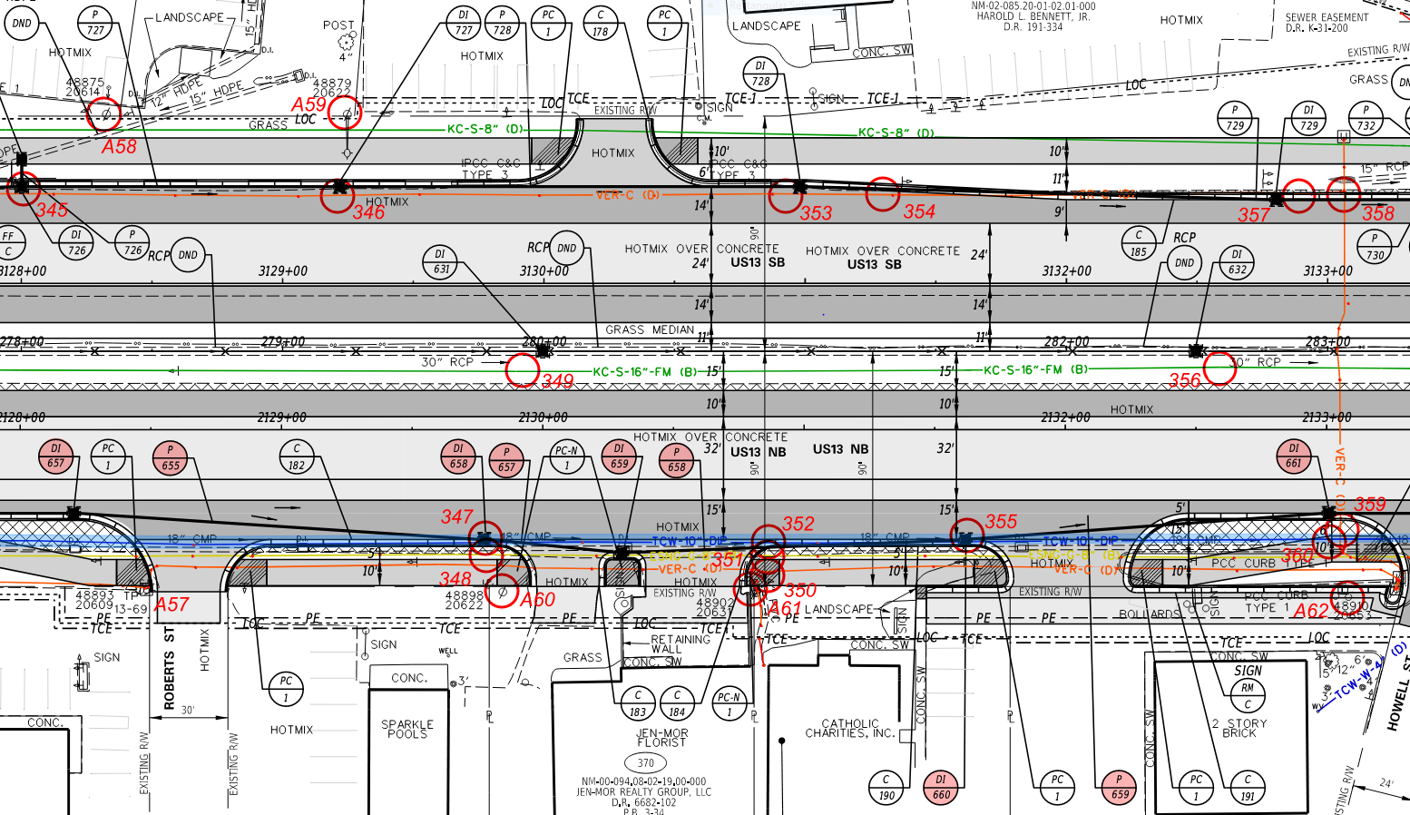
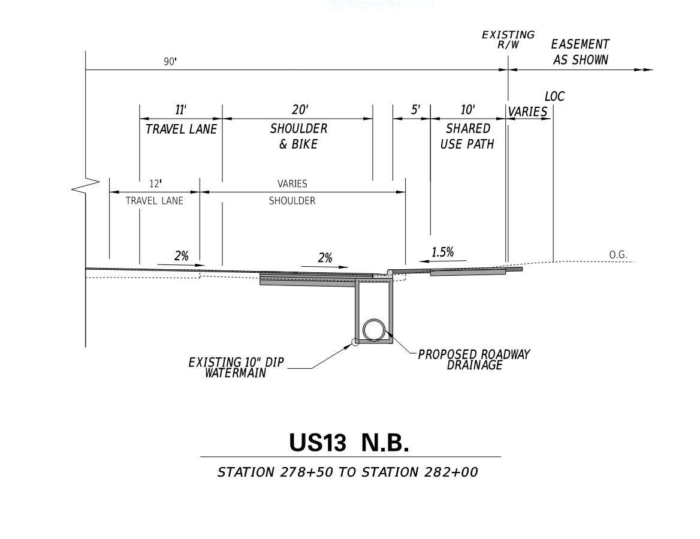
Us 13 – preliminary plans
Notes:
THE EXAMPLE FOCUSES ON A 10-INCH WATER MAIN OWNED BY THE CAMDEN WYOMING SEWER AND WATER AUTHORITY, WHICH IS HIGHLIGHTED IN BLUE ON THE PRELIMINARY PLAN.
THE PROJECT DESIGN REQUIRED THAT THE PROPOSED 10’ WIDE OUTSIDE SHOULDER BE WIDENED TO 20’ BETWEEN STA 278+50 TO STA 282+00.
THIS WAS NECESSARY TO PROVIDE PARKING OPPORTUNITIES FOR SEVERAL SMALL BUSINESSES FRONTING US 13.
THE WIDENING CREATED A POTENTIAL CONFLICT BETWEEN THE 10-INCH WATER MAIN AND THE PROPOSED ROADWAY DRAINAGE SYSTEM.
POTENTIAL UTILITY CONFLICTS WERE NOTED IN RED ON THE PRELIMINARY PLANS AND ASSIGNED CONFLICT ID NUMBERS.
CONFLCIT ID’S FOR AERIAL FACILITIES WERE GIVEN AN “A” PREFIX TO DENOTE AERIAL.

Slide 18
Notes:
INFORMATION FOR EACH POTENTIAL CONFLICT WAS ENTERED INTO THE PROJECT UCM AND THEN MADE AVAILABLE TO THE UTILITY COMPANIES ALONG WITH THE PRELIMINARY PLANS.

Slide 19
Notes:
THROUGH COORDINATION WITH THE UTILITY OWNERS, TEST HOLE LOCATIONS WERE IDENTIFIED WHERE NEEDED TO CONFIRM UNDERGROUND CONLICTS.
THE TEST HOLE RESULTS WERE ADDED TO THE UCM AND EACH CONFLICT WAS EVALUATED TO DETERMINE A POTENTIAL RESOLUTION.
THE OWNER OF THE 10” WATER MAIN REQUESTED THAT DELDOT INVESTIGATE AN ALTERNATIVE DRAINAGE SYSTEM DESIGN IN ORDER FOR THEM TO AVOID HAVING TO RELOCATE THEIR FACILITY.
THE PARTIES AGREED TO DEVELOP A RESOLUTION BEFORE JUNE 30, 2019 SO AS NOT TO DELAY THE PROJECT SEMI-FINAL PLAN SUBMISSION.

Slide 20
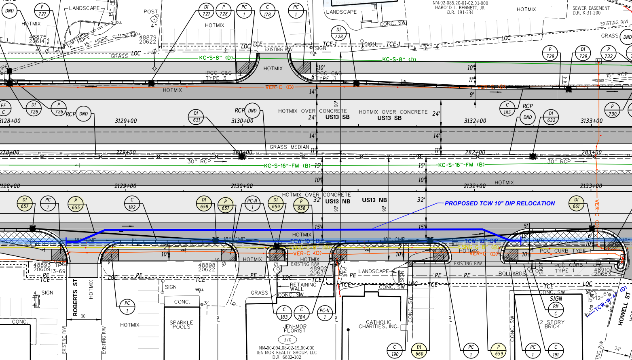
Alternative 1 – relocate 10” DIP water main
Notes:
TWO ALTERNATE DESIGNS WERE EVALUATED:
THE FIRST ALTERNATIVE CONSIDERS RELOCATING THE 10-INCH WATER MAIN TO AVOID THE PROPOSED ROADWAY DRAINAGE.

Slide 21
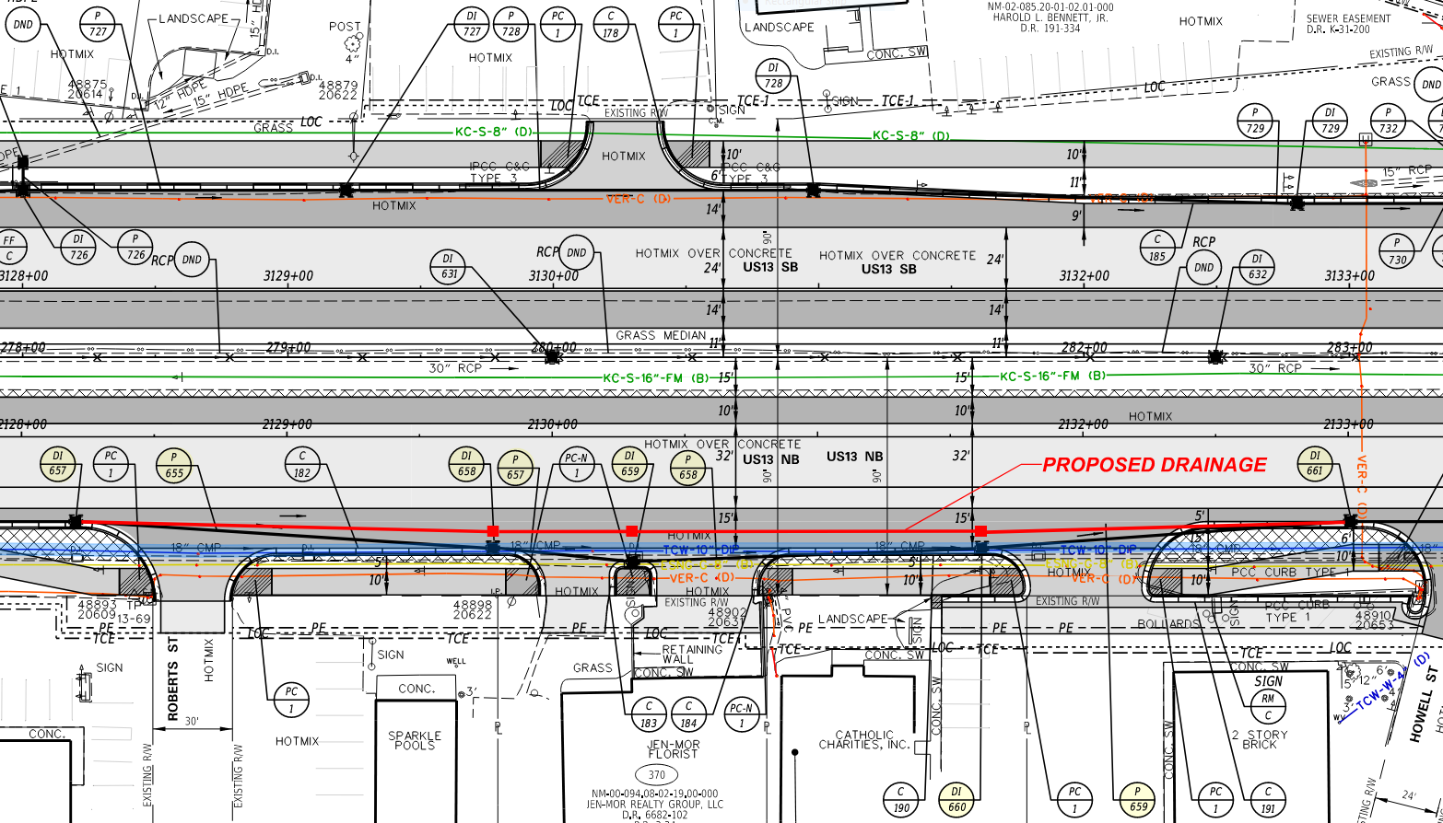
Alternative 2 – redesign drainage system
Notes:
THE SECOND ALTERNATIVE SHIFTS THE DRAINAGE SYSTEM AWAY THE 10-INCH WATER MAIN BY CREATING A SHALLOW SWALE IN THE PAVEMENT BETWEEN THE SHOULDER AND THE PARKING AREA.

Slide 22
Notes:
COST ESTIMATES WERE PREPARED FOR EACH ALTERNATIVE AND ENTERED INTO THE COST ESTIMATE ANALYSIS WORKSHEET.
EACH ALTERNATIVE WAS EVALUATED FOR CONSTRUCTABILITY AND BOTH WERE DEEMED FEASIBLE TO CONSTRUCT.
ALTERNATIVE 2 WAS THE CLEAR CHOICE FOR THE PREFERRED ALTERNATIVE.

Slide 23
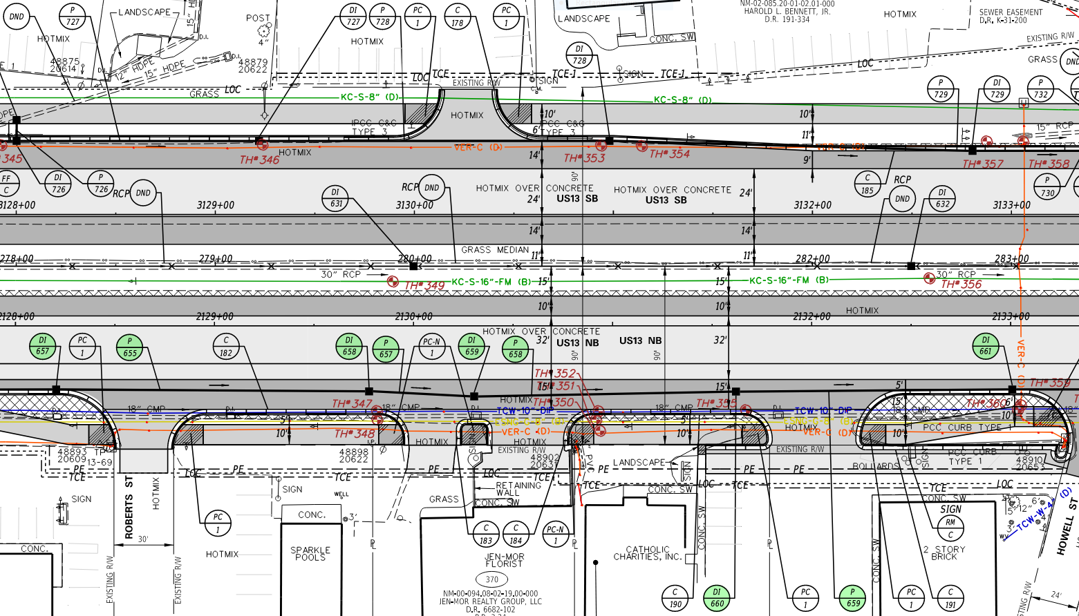
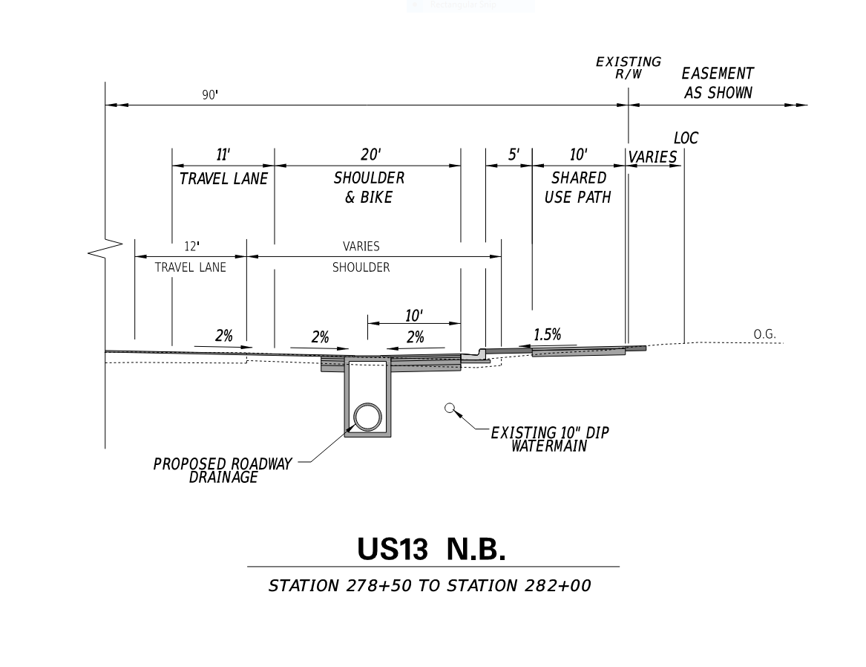
Us 13 – semi-final plans
Notes:
THE SEMI-FINAL PLANS WERE SUBMITTED WITH THE REVISED TYPICAL SECTION AND DRAINAGE PLAN.

Slide 24
Notes:
THE SEMI-FINAL UCM WAS ADJUSTED ACCORDINGLY AND RECORDED THAT THE CONFLICT BETWEEN THE PROPOSED ROADWAY DRAINAGE SYSTEM AND THE 10-INCH WATER MAIN HAD BEEN RESOLVED.

Slide 25
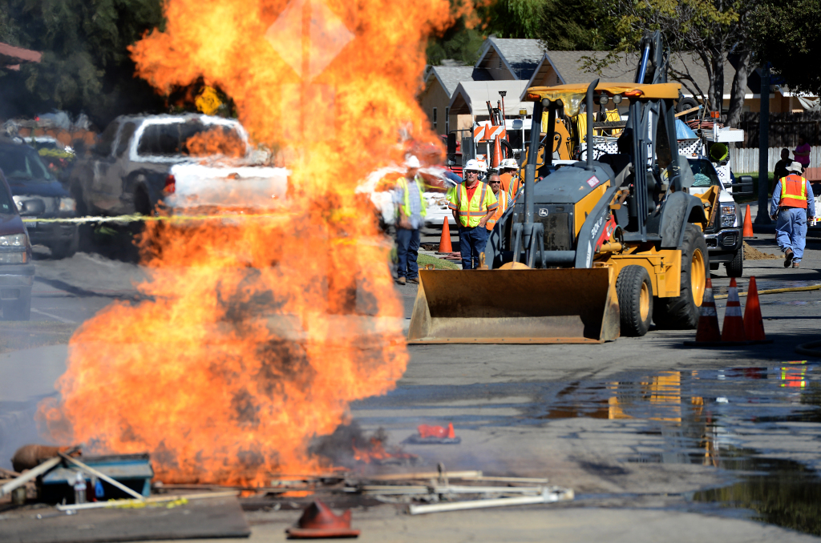
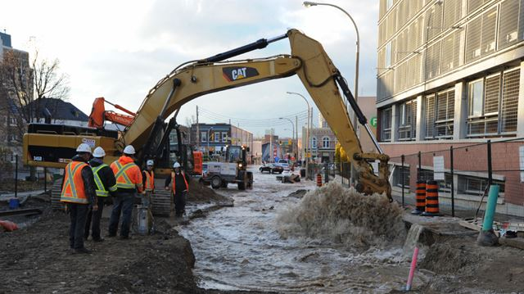
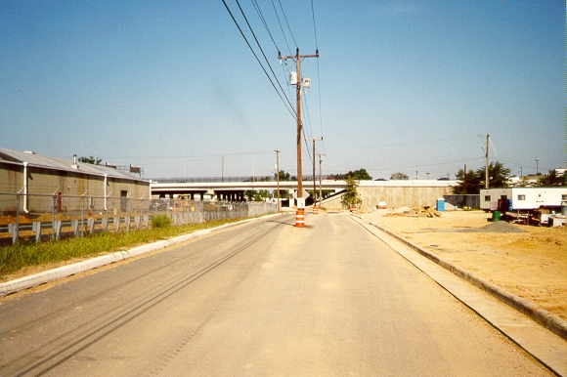
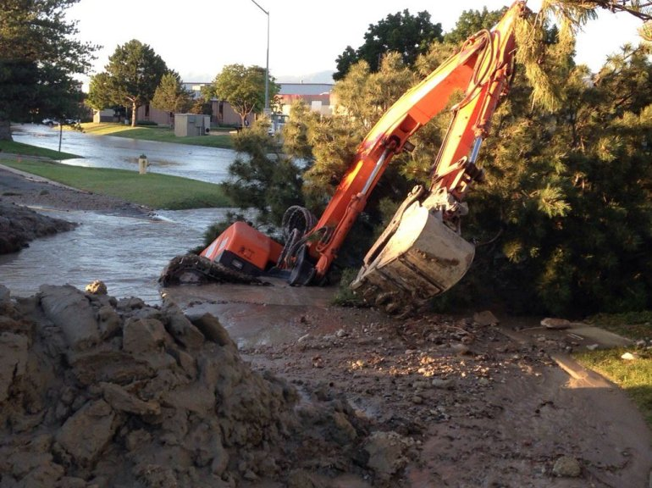
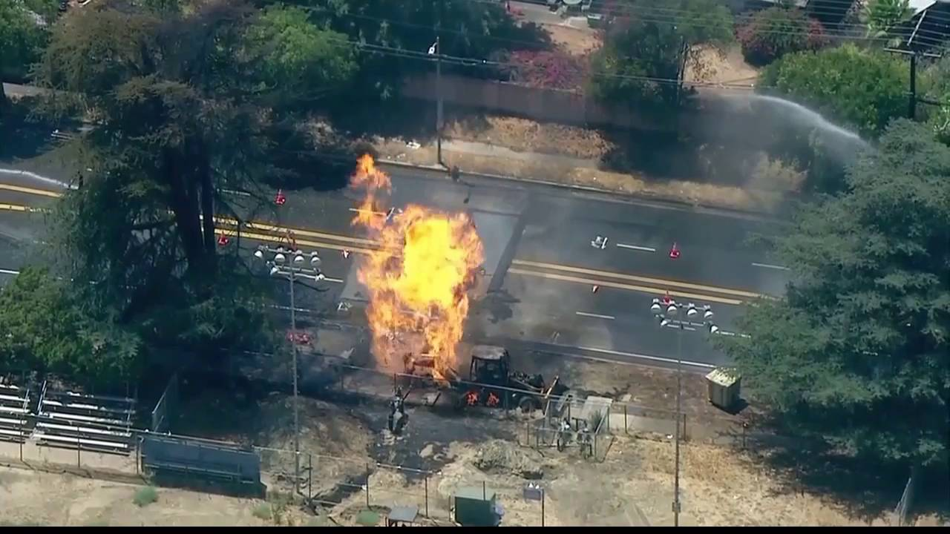
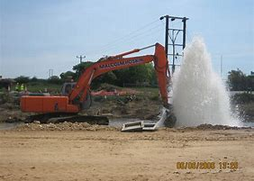
SUMMARY
Notes:
IN SUMMARY, UTILITY CONFLICT MANAGEMENT IS EXTREMELY IMPORTANT TO THE ULTIMATE SUCCESS OF A PROJECT.
UNFORESEEN UTILITY CONFLICTS CAN HAVE NEGATIVE IMPACTS TO A PROJECT’S TIMING, BUDGET AND EFFECT ON THE PUBLIC.
TOOLS SUCH AS THE UCM HAVE BEEN DEVELOPED TO ASSIST PROJECT DESIGNERS AND COORDINATORS WITH MANAGING AND RESOLVING UTILITY CONFLICTS BEFORE THEY BECOME SERIOUS ISSUES.
ADDITIONAL INFORMATION REGARDING UTILITY PLAN DEVELOPMENT AND COORDINATION CAN BE FOUND IN THE DESIGN RESOURCE CENTER LOCATED ON THE DELDOT WEBSITE.

