Slide 1
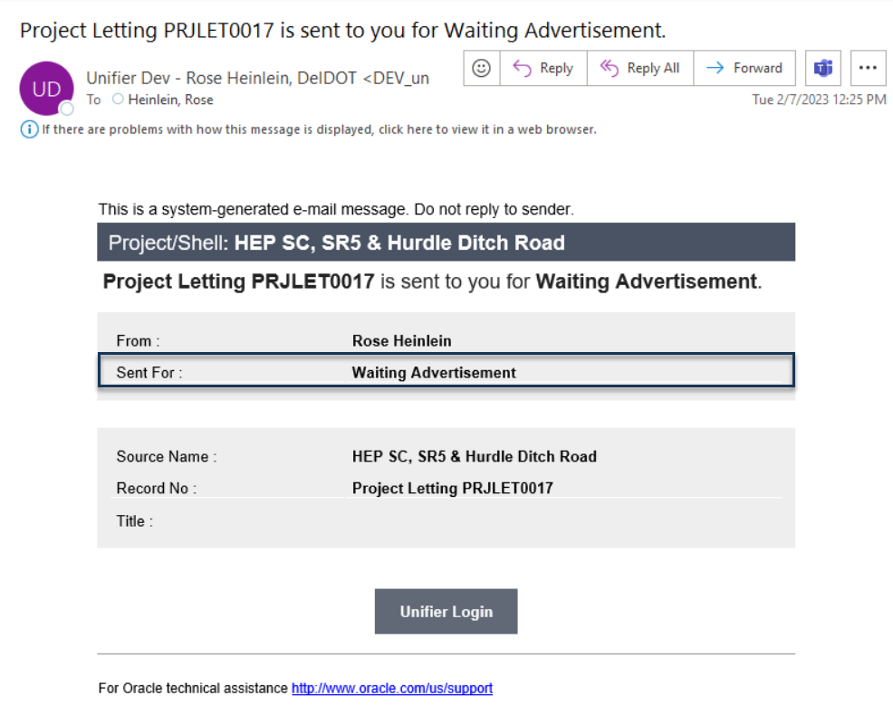
PS&E and Project Letting
PS&E
Once the PS&E record is approved by Engineering support the Project Letting Record is auto-created.
Auto-creation skips the Creation step in Project Letting and assigns to Contract Administration

Slide 2
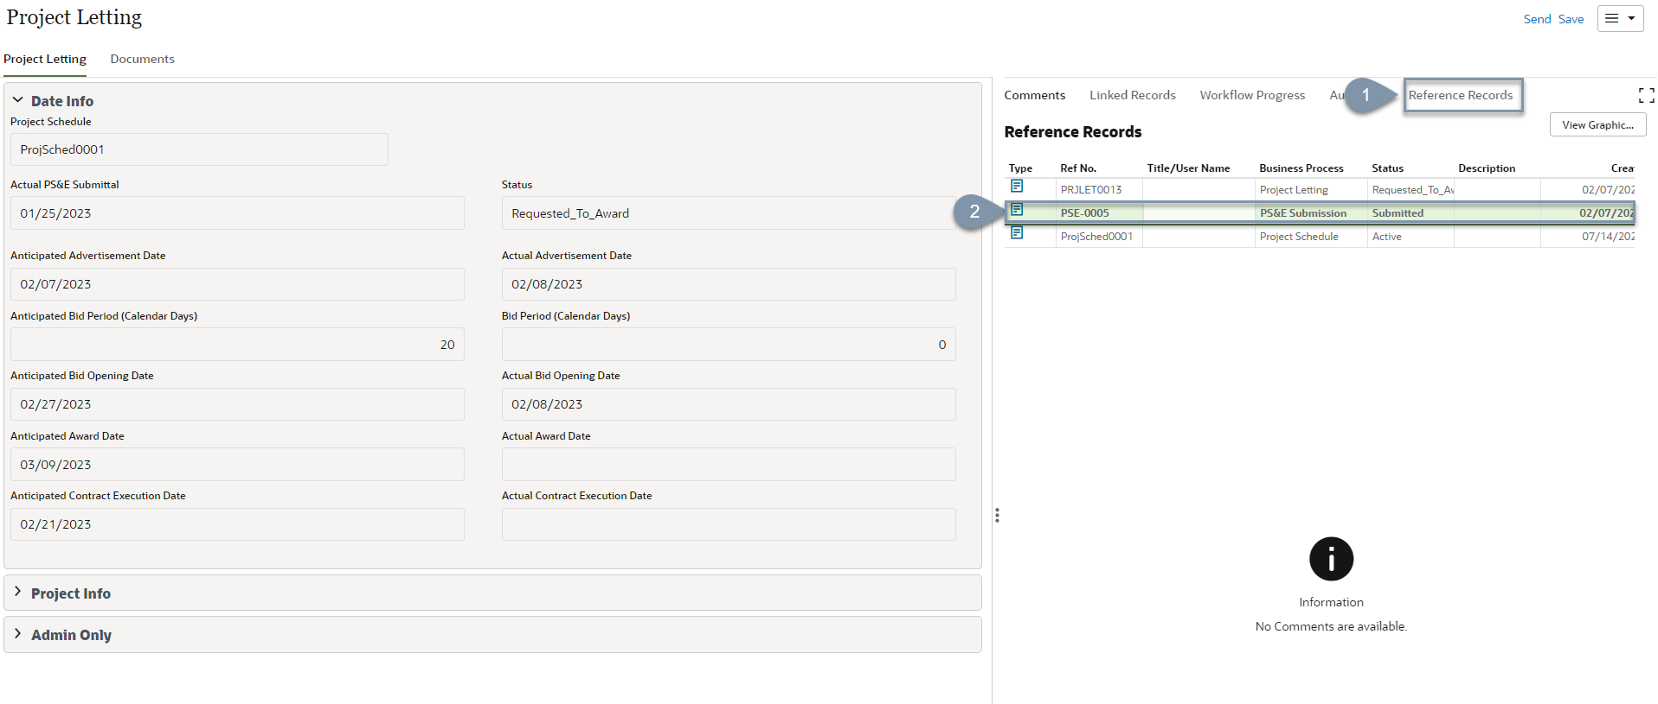
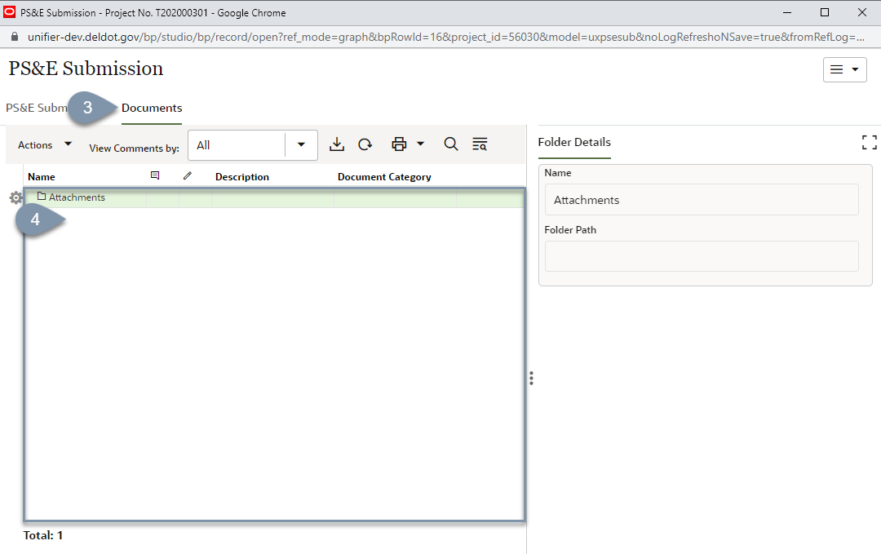
Reference Record Item-PS&E Records
Required Actions
Select the 'Referenced Records' option
Double Click the PS&E Submission Record
The PS&E record that auto-created Project Letting will open.
3. Open the Documents Form in the PS&E record
4. Documents in this record are the final Statement versions.

Slide 3
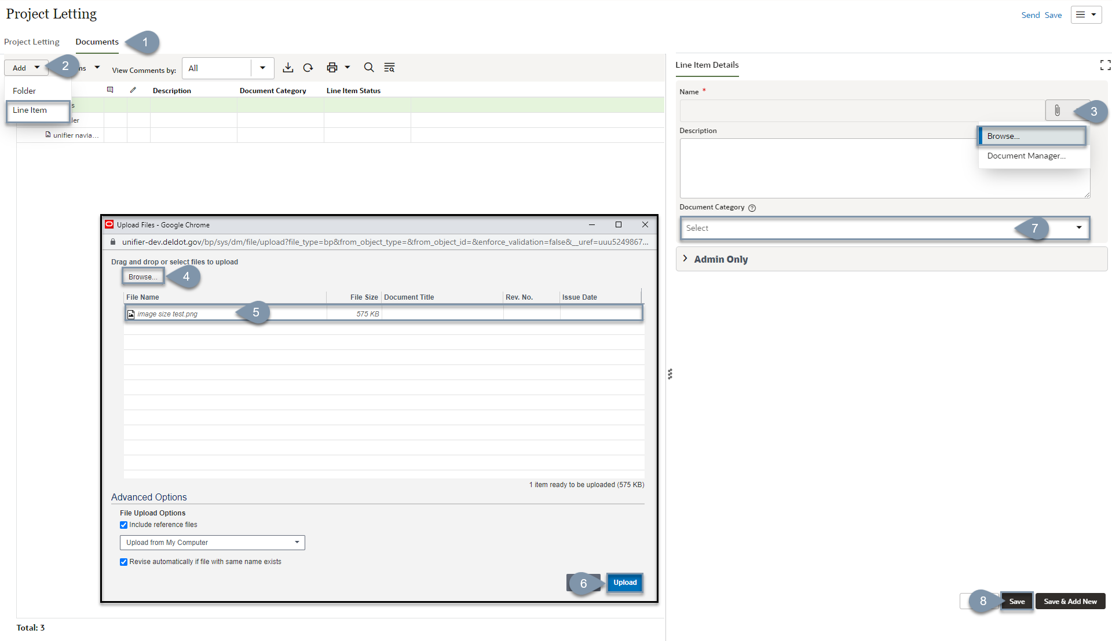
Uploading Project Letting Documents
Required Actions
Select the 'Documents' form
Select 'Add', then select 'Line Item'
Select the attach icon, then select 'Browse'
Select 'Browse' and select a document.
The document will appear as a line item.
Select 'Upload'
Select the document category from the dropdown list.
Select 'Save'

Slide 4
Project Letting Workflow
WF-
Creation*
Waiting Advertisement
Advertised
Bids Under Review
Request to Award
Awarded
Executed
End
*Creation
A new record can be initiated if the project has been readvertised.

Slide 5
Saving a Record
When adding dates to an Upper Form, you can leave the record and come back to make edits later by selecting the ‘Save’ option. After selecting ‘Save’ the record is stored in the drafts folder.
Only the individual who has accepted the task can see the draft version.

Slide 6
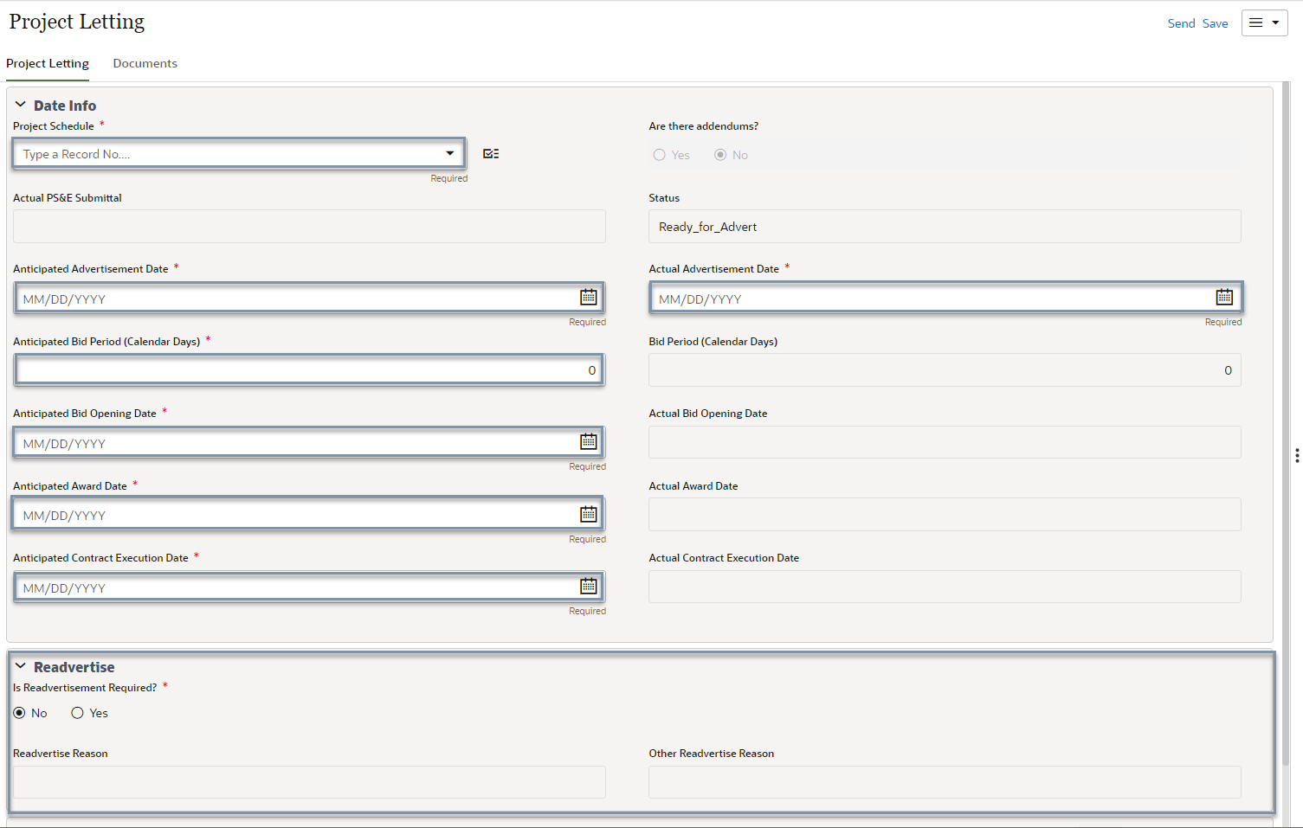
Waiting Advertisement
Required Fields
Project Schedule- select from the picker
Anticipated / Planned Dates
Advertisement Date- select date
Bid Period (calendar days)- enter numeric value
Bid Opening Date- select date
Award Date- select date
Contract Execution Date- select date
Actual Advertisement Date- select date
Readvertise- Defaults to ‘No’, if readvertisement is needed, select yes and then select the Readvertisement reason.
Workflow Actions
Advertised- moves forward in the workflow
Readvertise- terminates record

Slide 7
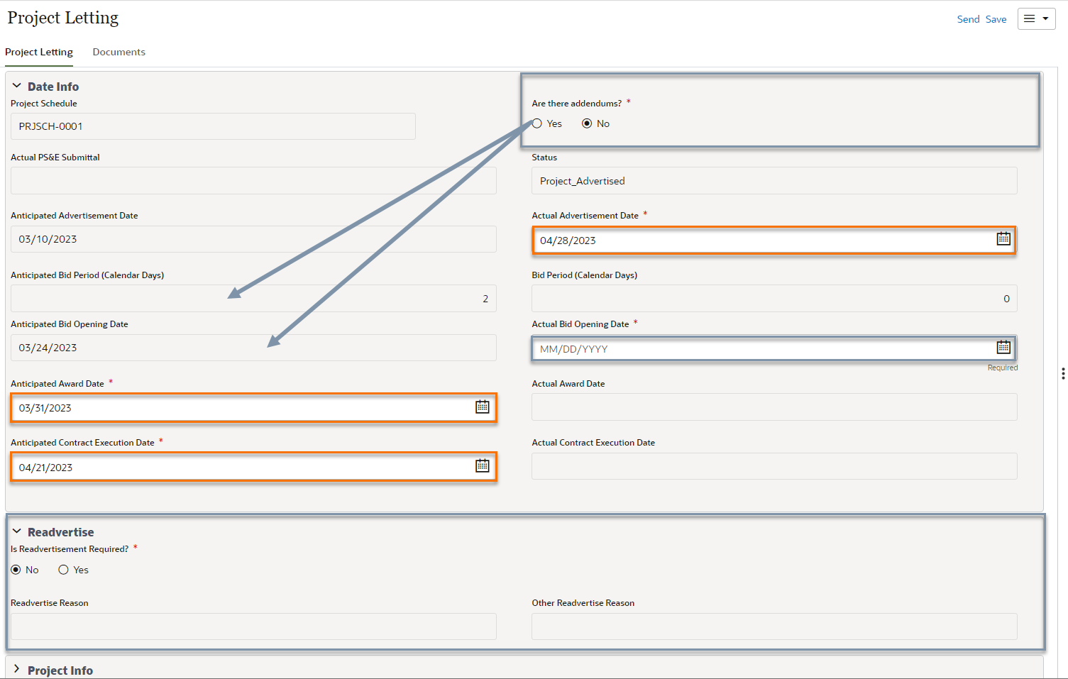
Advertised
Required Fields
Are there Addendums- select yes or no
If Yes is selected, the Anticipated Bid Period (Calendar Days) and Anticipated Bid Opening Date are editable.
Actual Bid Opening Date- select date
Modify/Edit if needed
Actual Advertisement Date- update date
Anticipated Award Date- update date
Anticipated Contract Execution Date- update date
Readvertise- Defaults to ‘No’, if readvertisement is needed, select yes and then select the Readvertisement reason.
Workflow Actions
Review Bids- moves forward in the workflow
Readvertise- terminates record

Slide 8
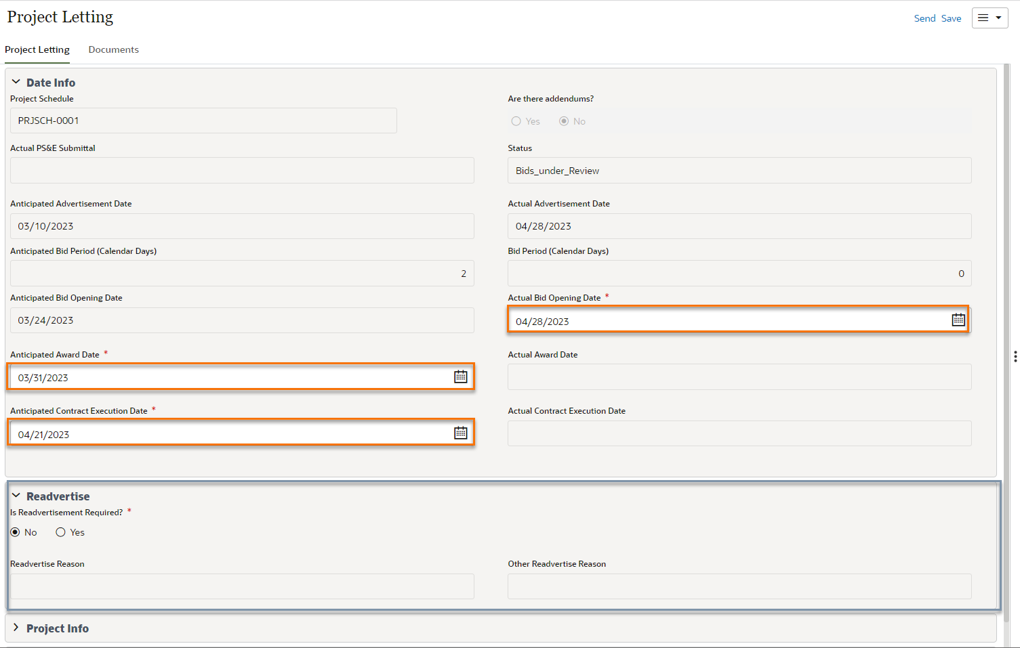
Review Bids
Bids are reviewed. Documents are sent to Design PM for review and waiting on RTA.
Required Fields
None
Modify/Edit if needed
Actual Bid Opening Date- select date
Anticipated Award Date- select date
Anticipated Contract Execution Date- select date
Readvertise- select the readvertisement reason from the dropdown. If readvertisement is not needed, select ‘None’
Workflow Actions
Request to Award- moves forward in the workflow
Readvertise- terminates record

Slide 9
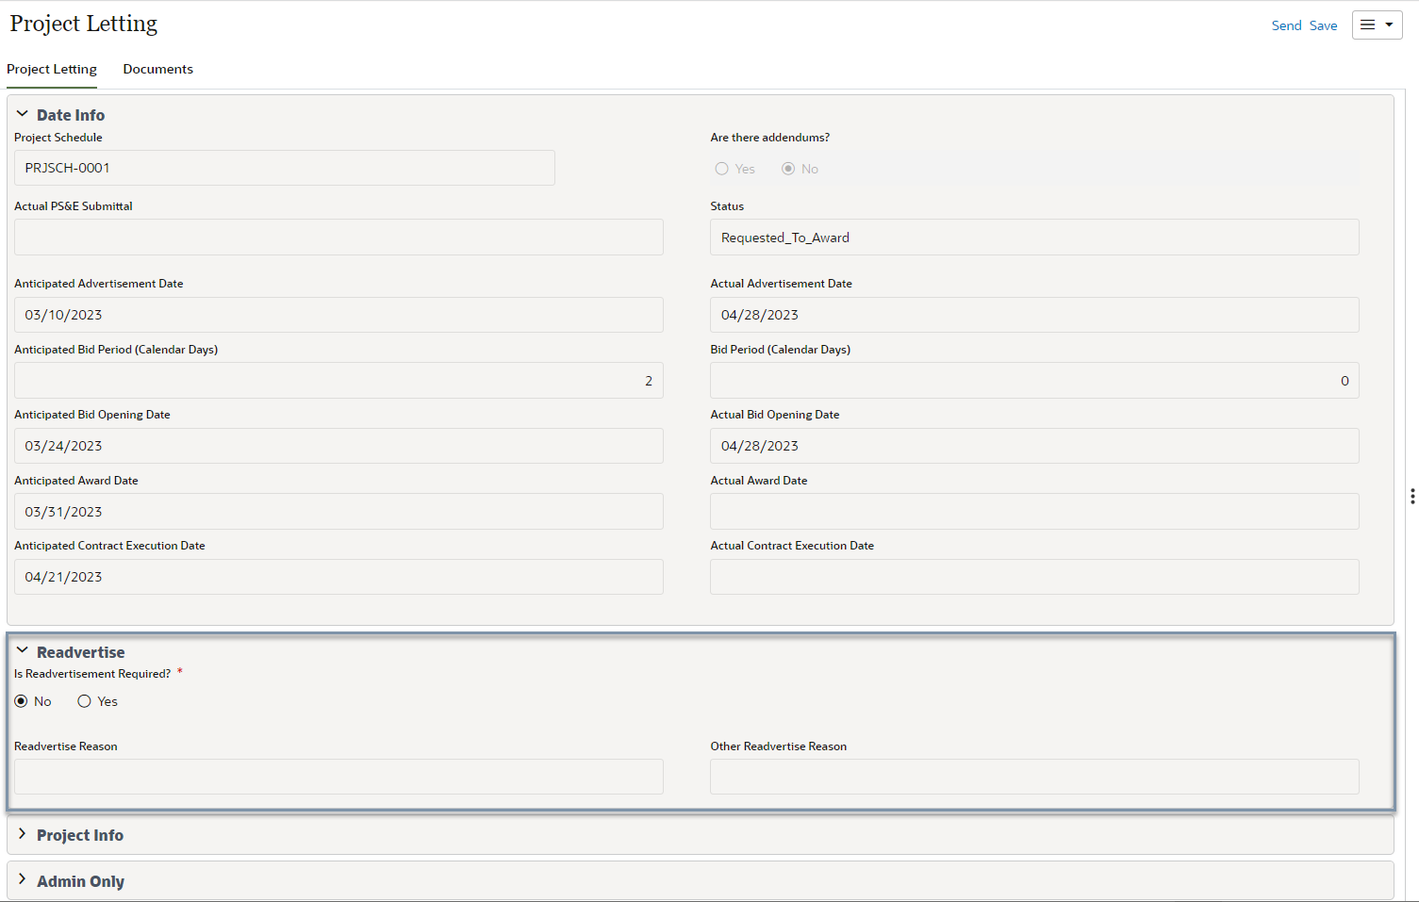
Request to Award
Required Fields
None
Fields that can be edited
Readvertise- select the readvertisement reason from the dropdown. If readvertisement is not needed, select ‘None’
Workflow Actions
Pending Award- moves forward in the workflow
Readvertise- terminates record

Slide 10
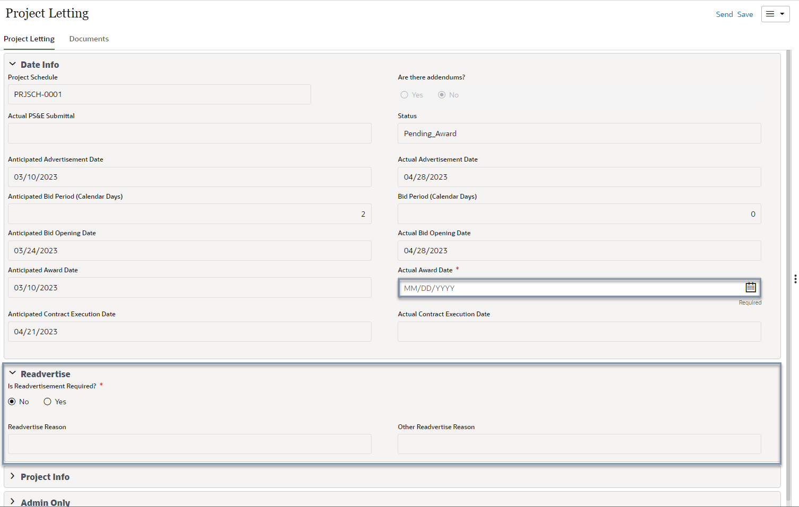
Award
After receiving RTA, the record status is updated to Awarded.
Required Fields
Actual Award Date- select date
Fields that can be edited
Readvertise- select the readvertisement reason from the dropdown. If readvertisement is not needed, select ‘None’
Workflow Actions
Executed- moves forward in the workflow
Readvertise- terminates record

Slide 11
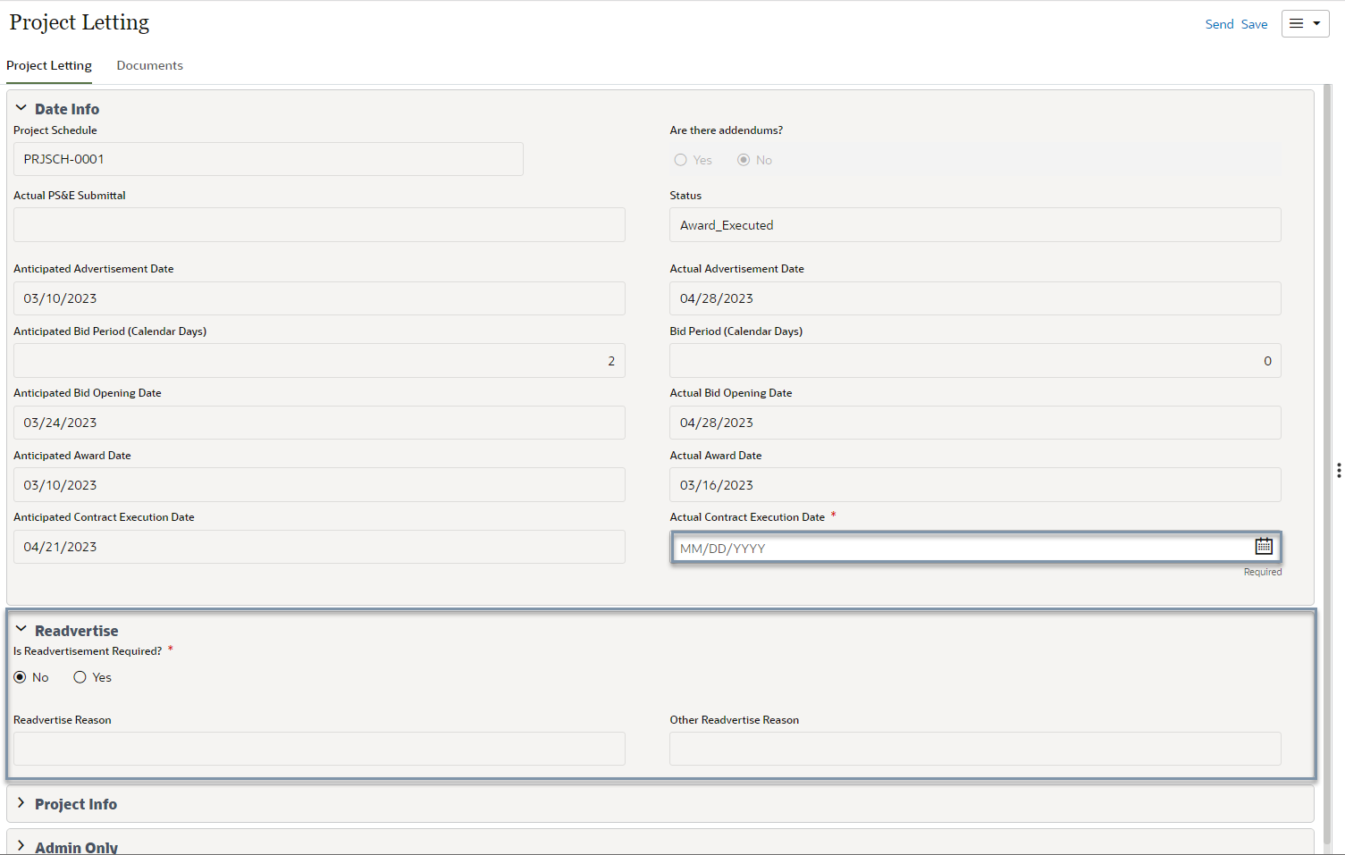
Executed
Required Fields
Actual Contract Execution Date- select date
Fields that can be edited
Readvertise- select the readvertisement reason from the dropdown. If readvertisement is not needed, select ‘None’
Workflow Actions
Closed- ends the record, view only after this action

Slide 12
Status
Status
If a record is Readvertised the record status = ReAdvert_Reqd
When records are completed the record status= Closed
Staus reflects the current stage in the workflow

Slide 13
Creating a New Project Letting Record
Select 'Create'

